Slide 1
ISBA-CTRIP CMIP6
Assignment week 6-7-21
Qingfang Bi
qbi@bgc-jena.mpg.de

Slide 2
1. Model name
ISBA-CTRIP
Interaction Soil-Biosphere-Atmosphere – CNRS Total Runoff Integrating Pathways coupled system
2. Lead PI
Bertrand Decharme (bertrand.decharme@meteo.fr), CNRS (France)

Slide 3
3. Static or dynamic vegetation
Static
4. Number of plant functional types
16
temperate broadleaf deciduous trees
boreal needleleaf evergreen trees
tropical broadleaf evergreen trees
C3 crops
C4 crops
irrigated C4 crops
C3 grass
C4 grass
Wetland
tropical broadleaf evergreen trees
temperate broadleaf evergreen trees
temperate needleleaf evergreen trees
boreal broadleaf deciduous
boreal needleleaf deciduous
boreal grass
deciduous shrubs

Slide 4
5. What disturbances are simulated
land use
fire
6. Number of pools
7 (four litter and three soil carbon pools)

Slide 5
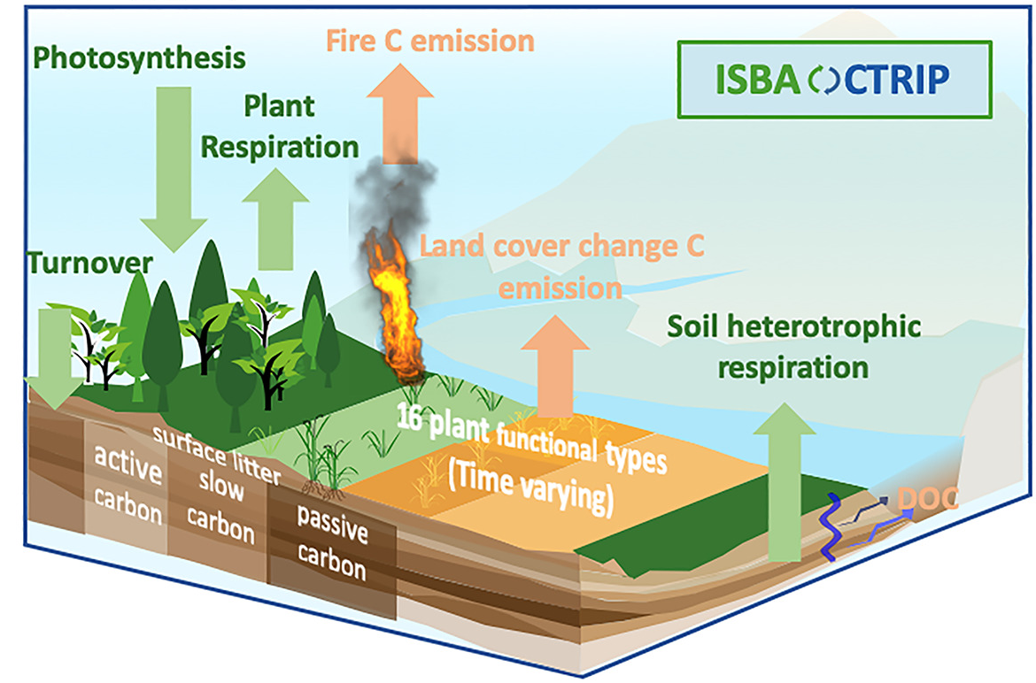
7.
Earth System - model CNRM-ESM2-1
CO₂
Delire et al., 2020
Leaf
Aboveground metabolic litter
Photosynthesis
CO₂
CO₂
Active pool
Belowground metabolic litter
Root
CO₂
CO₂
Aboveground structure litter
CO₂
Slow pool
CO₂
DOC
Steam
Belowground structure litter
CO₂
Passive pool

Slide 6
8. CMIP6 output:
https://esgf-node.ipsl.upmc.fr/search/cmip6-ipsl/

Slide 7
Earth System - model CNRM-ESM2-1
an improved representation of GPP and Ra for 16 PFTs whose area change yearly according to land cover change data.
The forthcoming paper of Séférian et al. (in prep) details the modelling setup use for CMIP6 (including the use of recommended forcing and the spin-up strategy) and evaluates the performance of CNRM-ESM2-1 with respect to CNRM-CM6-1.
Notes:
ISBA_bgc6 has an improved representation of GPP and Ra for 16 PFTs whose area change yearly according to land cover change data. The carbon flux resulting from the land cover change is called fLCC. ISBA_bgc6 also has a fire module that calculates area burned and carbon emissions (fire C). Finally, ISBA_bgc6 has a simple representation of dissolved organic carbon (DOC) leaching through the soil and transported to the ocean.
The « Earth system » version of ISBA-CTRIP has a full representation of the land carbon cycle. The land biogeochemical module in ISBA represents plant physiology (photosynthesis and autotrophic respiration), carbon allocation and turnover, and carbon cycling through litter and soil. It also includes a module for wild fires, land cover changes, and carbon leaching through the soil. This dissolved organic carbon (DOC) is then transported to the ocean via the CTRIP hydrographic network.

